Slide 1
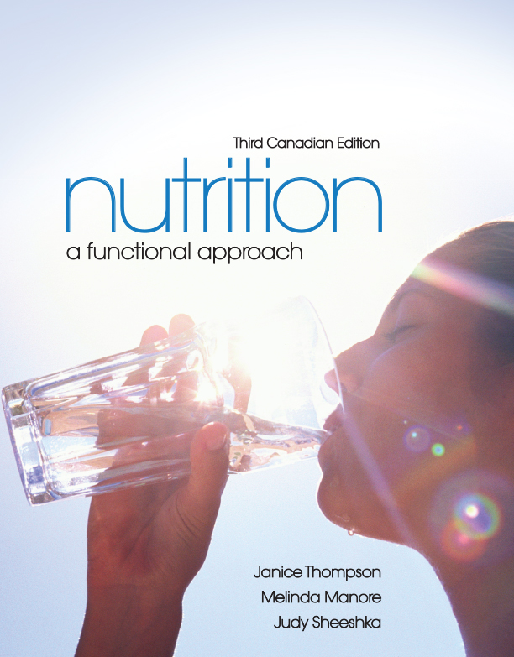
The Role of Nutrition in Our Health and In Depth
[Insert new 3C/image here]

Slide 2
What Is Nutrition?
Nutrition: the study of food, including
  How food nourishes our bodies
  How food influences our health
Nutrition is a relatively new discipline of science
Nutrition research focuses on supporting wellness and preventing and treating chronic diseases

Slide 3
Why Is Nutrition Important?
Nutrition contributes to wellness
Wellness: the absence of disease
  Physical, emotional, social, occupational, and spiritual health
Critical components of wellness
  Nutrition
  Physical activity

Slide 4
Why Is Nutrition Important?
Nutrition encompasses the following aspects of food
  Consumption
  Digestion
  Absorption
  Metabolism
  Storage
  Excretion

Slide 5
Why Is Nutrition Important?
Nutrition also studies these aspects of food
  Psychological
  Food safety
  Global food supply
  Cultural

Slide 6

Why Is Nutrition Important?
Figure 1.1

Slide 7
Why Is Nutrition Important?
Nutrition can prevent disease
  Nutrient-deficiency diseases: e.g.,
  scurvy, goiter, rickets
  Diseases influenced by nutrition:
  chronic diseases: e.g., heart disease, type 2 diabetes
  Diseases in which nutrition plays a role: e.g., osteoarthritis, osteoporosis, obesity

Slide 8
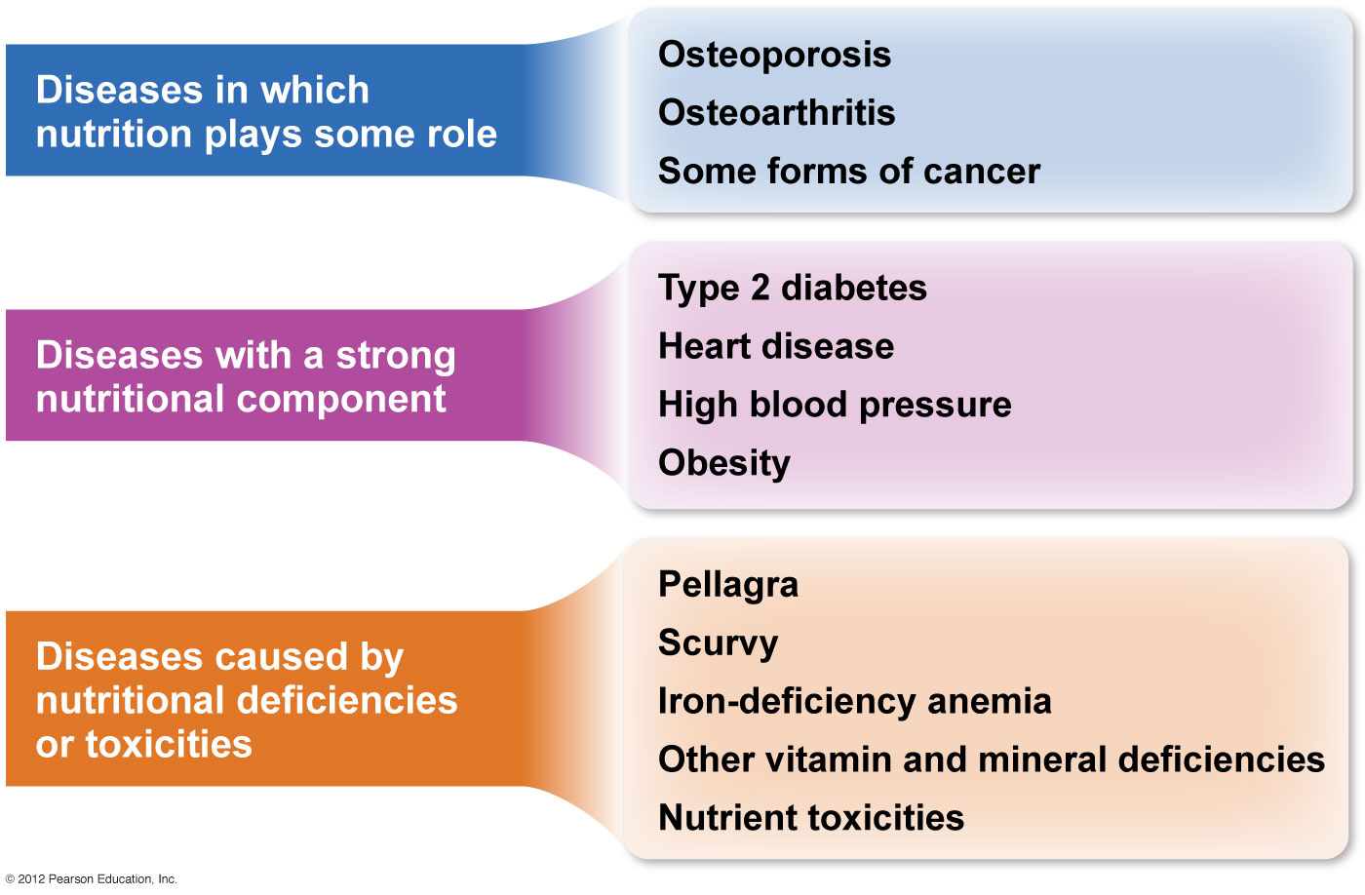
Why Is Nutrition Important?
<Insert fig 1.2>
Figure 1.2

Slide 9
What Are Nutrients?
Nutrients: chemicals in foods that are critical to human growth and function
There are 6 groups of essential nutrients found in foods
carbohydrates vitamins
fats and oils minerals
proteins water

Slide 10
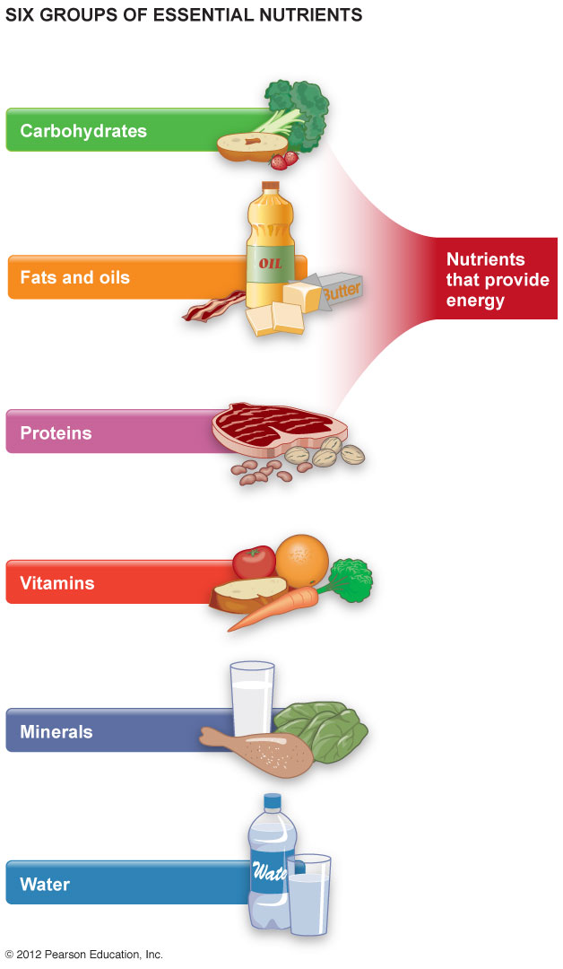
What Are Nutrients?
Figure 1.3

Slide 11
What Are Nutrients?
Macronutrients: nutrients required in relatively large amounts (g or Kg)
  Provide energy
  Carbohydrates, fats and oils, proteins
Micronutrients: nutrients required in smaller amounts (µg or mg)
  Vitamins and minerals

Slide 12
Energy from Nutrients
We measure energy in kilojoules (kJ) or kilocalories (kcal)
Kilocalorie: amount of energy required to raise the temperature of 1 kg of water by 1°C
In Canada: 1 kcal = 4.184 kJ
Canadian food labels use the term, Calorie

Slide 13
Carbohydrates
  Primary source of fuel for the body, especially for the brain and during exercise
  Provide 17 kJ/4 kcal per gram
  Found in grains (wheat, rice), vegetables, fruits, and legumes

Slide 14
Fats and Oils
  Composed of lipids, molecules that are insoluble in water
  Provide 37 kJ/9 kcal per gram
  Important energy source during rest or
  low-intensity exercise
  Found in butter, margarine, vegetable oils
  Source of fat-soluble vitamins and essential fatty acids

Slide 15
Proteins
  Chains of amino acids
  Can supply 17 kJ/4 kcal of energy per gram, but are not a primary energy source
  Important source of nitrogen

Slide 16
Proteins
Proteins are important for
  Building cells and tissues
  Maintaining bones
  Repairing damage
  Regulating metabolism
  Fluid balance
Protein sources include meats, dairy products, seeds, nuts, and legumes

Slide 17
Micronutrients
Vitamins and minerals are known as micronutrients
Vitamins: organic molecules that assist in regulating body processes
Vitamins are micronutrients that do NOT supply energy to our bodies
  Fat-soluble vitamins
  Water-soluble vitamins

Slide 18
Vitamins
Fat-soluble vitamins
  Vitamins A, D, E, and K
  Dissolve easily in fats and oils
Fat-soluble vitamins can be stored in the body
Toxicity can occur

Slide 19
Vitamins
Water-soluble vitamins
  Vitamin C and the B vitamins
  Remain dissolved in water
Excess water-soluble vitamins are eliminated by the kidneys and cannot be stored in our bodies

Slide 20
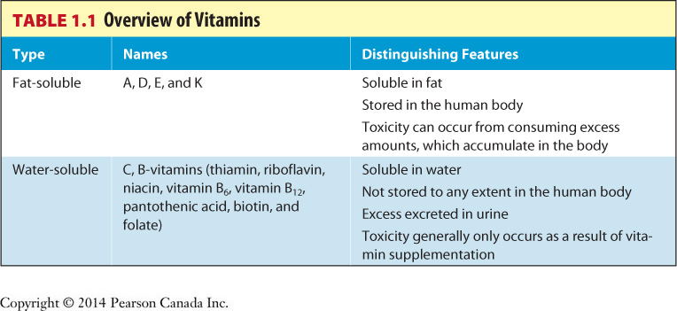
Vitamins
Table 1.1

Slide 21
Minerals
Minerals: inorganic substances required for body processes
Important minerals include sodium, calcium, iron, potassium, and magnesium
Minerals have many different functions, such as fluid regulation, bone structure, muscle movement, and nerve functioning

Slide 22
Minerals
Our bodies require at least 100 mg/day of the major minerals: calcium, phosphorus, magnesium, sodium, potassium, and chloride
We require less than 100 mg/day of the trace minerals: iron, zinc, copper, iodine, and fluoride

Slide 23
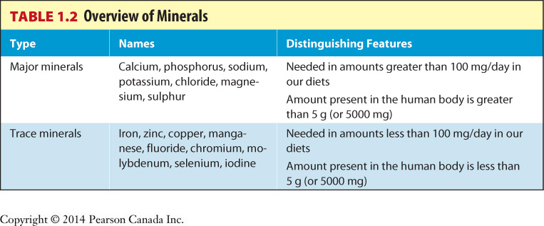
Minerals
Table 1.2

Slide 24
Water
Water is a critical nutrient for health and survival
Water is involved in many body processes:
fluid balance nutrient transport
nerve impulses removal of wastes
muscle contractions chemical reactions
and many, many more

Slide 25
Determining Nutrient Needs
DRIs identify the
  Amount of a nutrient needed to prevent deficiency disease in healthy people
  Amount of a nutrient that may reduce the risk of chronic disease
  Upper level of safety for nutrients

Slide 26
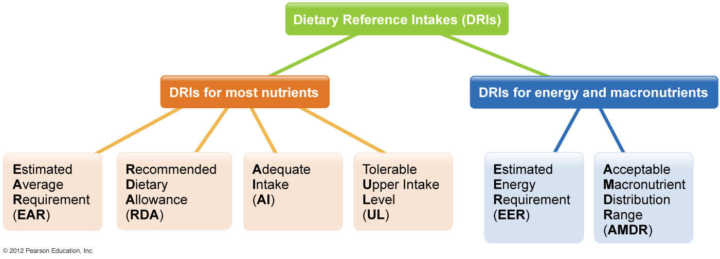
Determining Nutrient Needs
Figure 1.7

Slide 27
Determining Nutrient Needs
DRIs consist of 4 values
  Estimated Average Requirement (EAR)
  Recommended Dietary Allowance (RDA)
  Adequate Intake (AI)
  Tolerable Upper Intake Level (UL)

Slide 28
Determining Nutrient Needs
Estimated Average Requirement (EAR)
  The average daily intake level of a nutrient that will meet the needs of half of the healthy individuals in a particular life stage and gender group
  Are used to determine the RDA of a nutrient

Slide 29
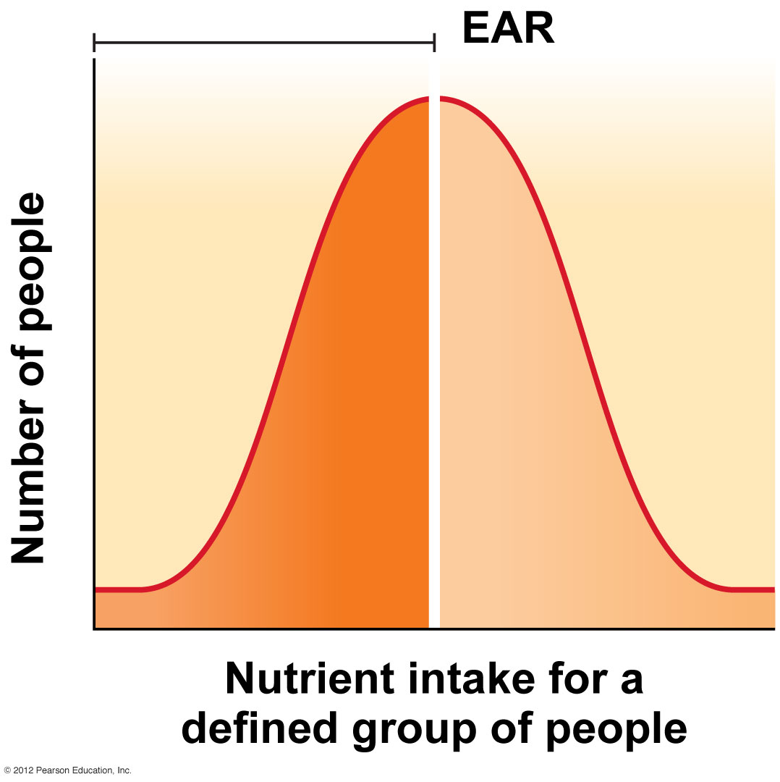
Determining Nutrient Needs: EAR
Figure 1.8

Slide 30
Determining Nutrient Needs
Recommended Dietary Allowance (RDA)
  The average daily intake level required to meet the needs of 97% to 98% of healthy individuals in a particular life stage and gender group

Slide 31
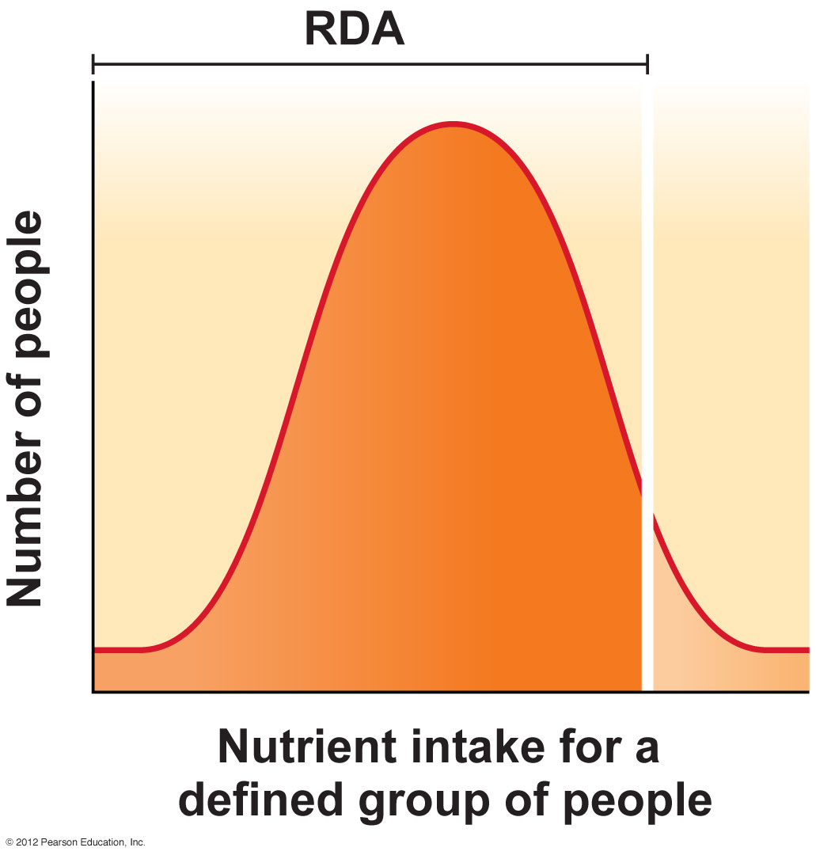
Determining Nutrient Needs: RDA
Figure 1.9

Slide 32
Determining Nutrient Needs
Adequate Intake (AI)
  Recommended average daily intake level for a nutrient
  Based on observations and estimates from experiments involving healthy people
  Used when the RDA cannot be determined: vitamin D, vitamin K, fluoride, and others

Slide 33
Determining Nutrient Needs
Tolerable Upper Intake Level (UL)
  Highest average daily intake level that is likely to pose no risk of adverse health effects to almost all individuals in a particular life stage and gender group
  Consumption of a nutrient at levels above the UL is not considered safe

Slide 34
Determining Nutrient Needs
Estimated Energy Requirement (EER)
  Average dietary energy intake (kcal) to maintain energy balance in healthy adults
  Based on age, gender, weight, height, and level of physical activity

Slide 35
Determining Nutrient Needs
Acceptable Macronutrient Distribution Range (AMDR)
  The portion of the energy intake that should come from each macronutrient
  The range of energy intake from carbohydrate, fat, and protein associated with reduced risk of chronic disease
  The range of macronutrient intake that provides adequate levels of essential nutrients

Slide 36
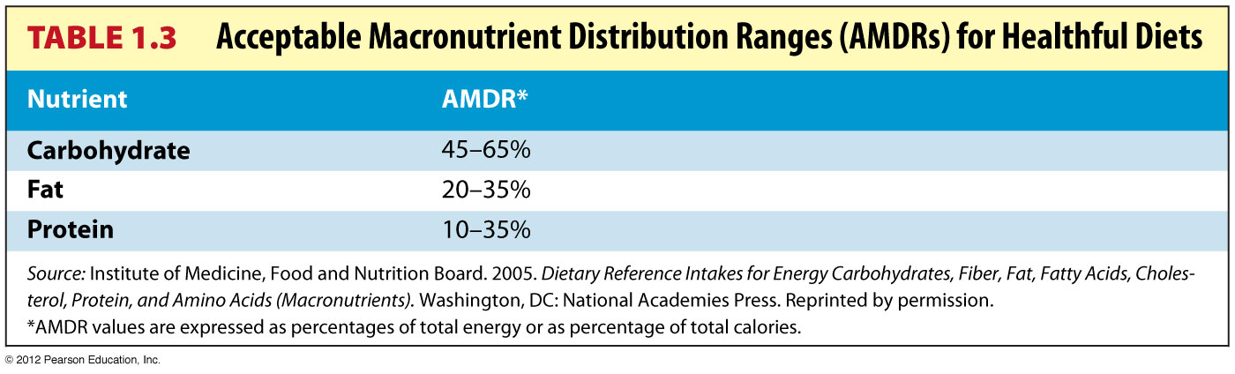
Determining Nutrient Needs: AMDR
Table 1.3

Slide 37
Nutrition Research
The scientific method
  Observation: describe the phenomenon
  Create a hypothesis
  Design, collect, and analyze the data
  Interpret the data
  Generalize the findings, develop a
  theory

Slide 38
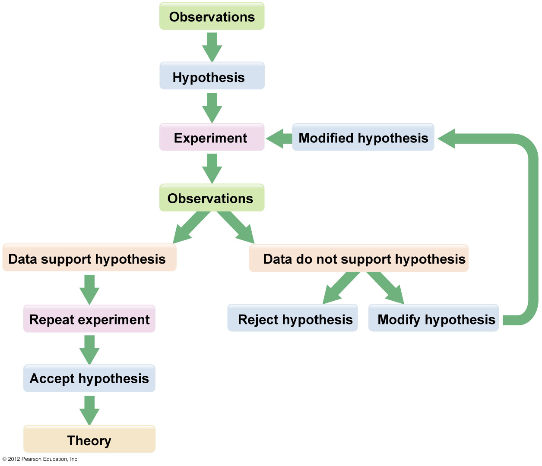
Nutrition Research
Figure 1.10

Slide 39
Research Terminology
Hypothesis
Educated guess as to why a phenomenon
occurs
Experiment
Scientific study used to test a hypothesis
Sample Size
Appropriate number to measure a difference
between treatment groups

Slide 40
Research Terminology
Control Group
Individuals who do not receive treatment
Theory
Conclusion drawn from repeated
experiments
Placebo
Inert substance with similar appearance
and taste

Slide 41
Research Terminology
Double-blind study
Neither subjects or researchers know who
is in the placebo or treatment groups
Psychosomatic effect (aka placebo effect)
Sometimes just knowing a subject is in a
study causes a person to experience
physiologic changes, which he/she may
interpret as therapeutic

Slide 42
Research Models
Epidemiological studies
Model systems
Animal studies
Human studies
  Case control studies
  Clinical trials
Note: Each type of study has advantages and disadvantages

Slide 43
Evaluating Media Reports
Ask these questions to determine scientific validity
Who is reporting the information?
Who conducted the research and who paid for it?
Is the report based on reputable research studies?
  Was there a control and an experimental group?
  Was the sample size large enough to rule out chance variation?
  Was a placebo effectively administered?
  Was it a double-blind study?

Slide 44
Evaluating Media Reports
Ask these questions to determine scientific validity (continued)
Is the report based on testimonials?
Are the claims too good to be true?
Prior to publication in reputable scientific journals, articles undergo peer review
Experiments must be repeated to confirm or disprove the findings

Slide 45
Reliable Sources of Information
Trustworthy experts
  Registered dietitian (RD)
  Nutritionist
  Professionals with advanced degree(s)
  in nutrition
  Medical doctor

Slide 46
Reliable Sources of Information
Government sources are usually trustworthy
Office of Nutrition Policy and Promotion, Health Products and Food Branch, Health Canada
Natural Health Products Directorate, Health Products and Food Branch, Health Canada
Canadian Food Inspection Agency, Bureau of Food Safety and Consumer Protection
Public Health Agency of Canada

Slide 47
Reliable Sources of Information
American Sources of information
National Institutes of Health (NIH)
Centers for Disease Control and Prevention (CDC)
The Academy of Nutrition and Dietetics (formerly called the American Dietetic Association/ADA)

Slide 48
Reliable Sources of Information
Professional organizations publish cutting-edge nutrition research and information, including
Dietitians of Canada (DC)
Canadian Society for Nutrition
Canadian Society of Nutrition Management
(CSNM)
International Society for Behavioural
Nutrition and Physical Activity (ISBNPA)

Slide 49
In Depth: Alcohol
Alcohols are chemical compounds characterized by a hydroxyl group
Commonly known as beverages containing ethanol made from fermented fruits, vegetables, or grains

Slide 50
In Depth: Alcohol
What is moderate alcohol intake?
A drink is defined as the amount of a beverage that provides 14 mL (0.5 fl. oz.) of pure alcohol
Proof is a measurement of alcohol content

Slide 51
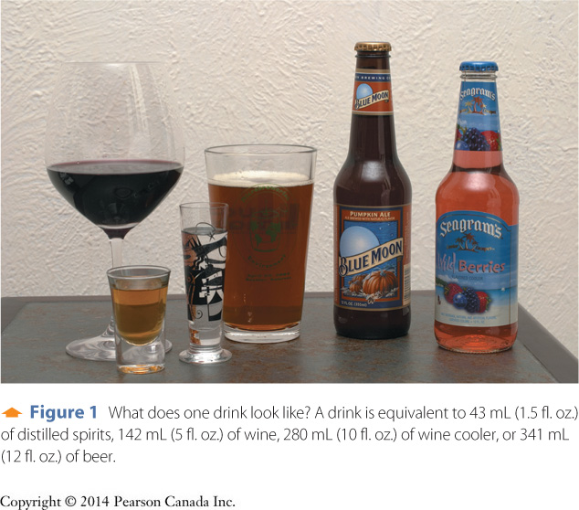
In Depth: Alcohol
Figure 1 In Depth

Slide 52
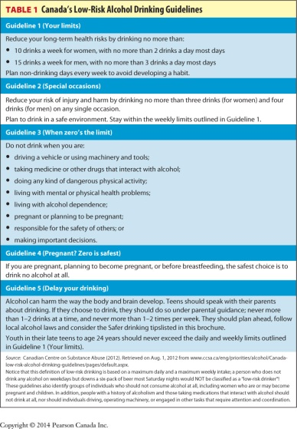
In Depth: Alcohol
Table 1 In Depth

Slide 53
In Depth: Alcohol
Benefits of moderate consumption include
Stress and anxiety reduction
Improved self-confidence
Appetite improvement
Lower rates of heart disease
Possible lower risks for diseases such as
diabetes, heart disease, and liver disease

Slide 54
In Depth: Alcohol
Concerns about moderate alcohol intake include
Women appear to be at higher risk for
breast cancer
Increased risk for hypertension
Higher rates of bleeding in the brain
Relatively high calorie content
Potential risk for adverse drug interactions

Slide 55
In Depth: Alcohol
Types of alcohol abuse
Alcohol abuse is excessive intake of alcohol
Binge drinking is consumption of 5 or more drinks per occasion (men) and 4 or more drinks per occasion (women)
Alcoholism is a disease characterized by
chronic dependence on alcohol

Slide 56
In Depth: Alcohol
Types of alcohol abuse (continued)
A hangover is a consequence of drinking too much
alcohol; symptoms include headache, fatigue, dizziness, muscle aches, nausea, sensitivity to
light, and extreme thirst
Alcohol poisoning is a potentially fatal metabolic
state involving cardiac or respiratory failure in
response to binge drinking
Liver damage

Slide 57
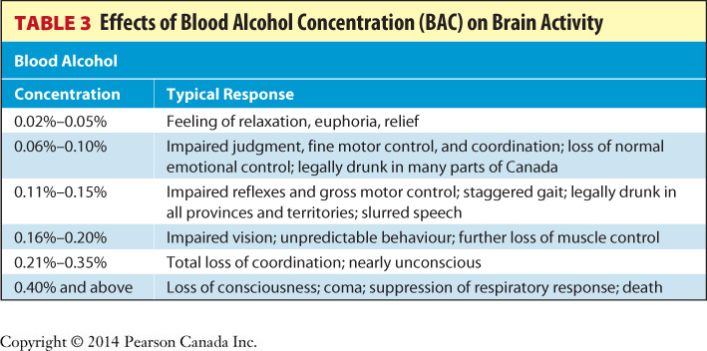
In Depth: Alcohol

Slide 58
In Depth: Alcohol
Fetal and infant health problems include
Fetal Alcohol Syndrome (FAS): a set of serious,
irreversible birth defects, including physical, emotional, behavioural, and developmental
problems
Fetal Alcohol Spectrum Disorder (FASD): a term
used to describe complications resulting from a
woman’s alcohol consumption during pregnancy

